Slide 1
Today
Lecture 21: Quantum Information Science and the role of Superconductivity
Discussion of applications of superconductor materials and devices in five parts:
Overview of the quantum information landscape
Macroscopic quantum phenomena in superconductor devices and superconductor qubits
Transmon qubit --- the leading qubit platform
Topological superconducting qubits based on Majorana fermion states
S-TI-S Josephson junctions --- a compelling platform
Next time
Lecture 21: Macroscopic quantum phenomena and superconductor qubits

Slide 2

PHYS 498 SQD Fall 2019
Superconductor Materials and Devices for Quantum Information Science
Relevance to Quantum Information Science:
There is probably no area hotter in science than quantum information
Recent discoveries and progress have made people worldwide aware of the potential of quantum mechanics for advanced detectors and quantum computing
There are significant investments by countries, industries, and universities (including ours) in this area:
UIUC has launched IQUIST = Illinois Quantum Information Science and Technology Center, and created CQE = Chicago Quantum Exchange, a consortium of partners in and near Chicago,
to promote activity in QIS, including encouraging training of students in QIS via courses like this
So, this NOT a course on QIS and I actually do NOT consider myself to be an expert in this emerging field
But superconductivity is one of the leading and most promising hardware approaches for achieving the goals of this effort and it is to likely play a major role in qubit devices and quantum circuits,
so I want to learn with you about what is happening and how to advance it
Throughout the course we will keep an eye on new developments and opportunities for superconductivity

Slide 3
Fundamental physics
Quantum cryptography
Entanglement
Secure key distribution
Decoherence
(even between
non-speaking parties)
Ultimate control over
“large” systems
Quantum→
classical
Quantum
Quantum communciation
Information
Teleportation
Linking separated
Quantum metrology
quantum systems
(“quantum network”)
Measurements beyond
the classical limit
Non-invasive measurements
Measurements on quantum
Quantum computation
systems
Factoring
Simulating other quantum
systems (>30bits)
Error correction

Slide 4
Quantum Information Timeline
Quantum
Computation
The expected
The unlikely – impossible?
Quantum
Widgets
Quantum
Engineered Photocells?
Difficulty/Complexity
Quantum
Sensors?
The known
The as yet unimagined!!!
Quantum
Measurement
Quantum
Communication
Quantum
Games & Toys
0 5 10 ~15 20? 25??
Time (years)

Slide 6
Transmon qubits produce microwave photons that could be converted to telecommunication photons for transmission and coupling
SC qubit platforms useful for quantum processing and error correction
Role of superconductivity
SC devices are leading platforms for qubits technologies
Conventional qubits: non-linearity of the Josephson inductance
Topological qubits: Majorana fermions nucleated in hybrid SC-topological
All: protection from dephasing by energy gap, intrinisic high-frequency scale that enables quantum phenomena, and low temperature operation
Superconducting detectors already offer quantum-limited sensitivity
Improvements possible by incorporating entanglement and squeezed-state techniques
Novel sensors incorporating SQUIDs may be important in dark matter searches for axions and WIMPS
Advanced materials and fabrication techniques are path to reduce dephasing
Topological materials to support Majorana fermions states
Topological materials are promising for computer interconnects

Slide 7
Primary drivers for Quantum information Science
Quantum computing ---- beyond Moore’s Law
2. Secure data communications --- encryption codes
3. Exciting science enabled by quantum computing

Slide 8
https://www.factbasedinsight.com/quantum-outlook-2019/

Slide 9


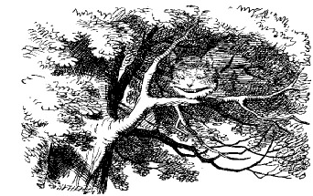
Quantum Cryptography
ALICE
BOB
KEY:
…010001010011101001…
Cipher:
…0110010110100010…
XOR(Cipher,Key)
Message
XOR(Message,Key)
Cipher
EVE

Slide 10
Entangled-Photon Quantum Cryptography
Alice & Bob randomly measure polarization in the (HV) or the (45 45) basis.
Discuss via a “public channel” which bases they used, but not the results.
Discard cases (50%) where they used different bases → uncorrelated results.
Keep cases where they used the same basis → perfectly correlated results!
Define H ≡ “0” ≡ 45, V ≡ “1” ≡ −45. They now share a secret key.

Slide 11
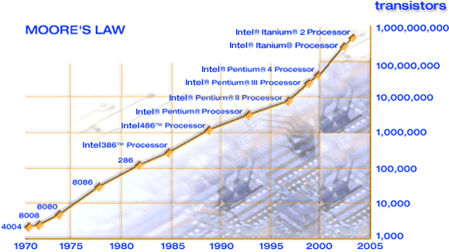
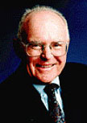
Moore’s Law
Source: Intel

Slide 12
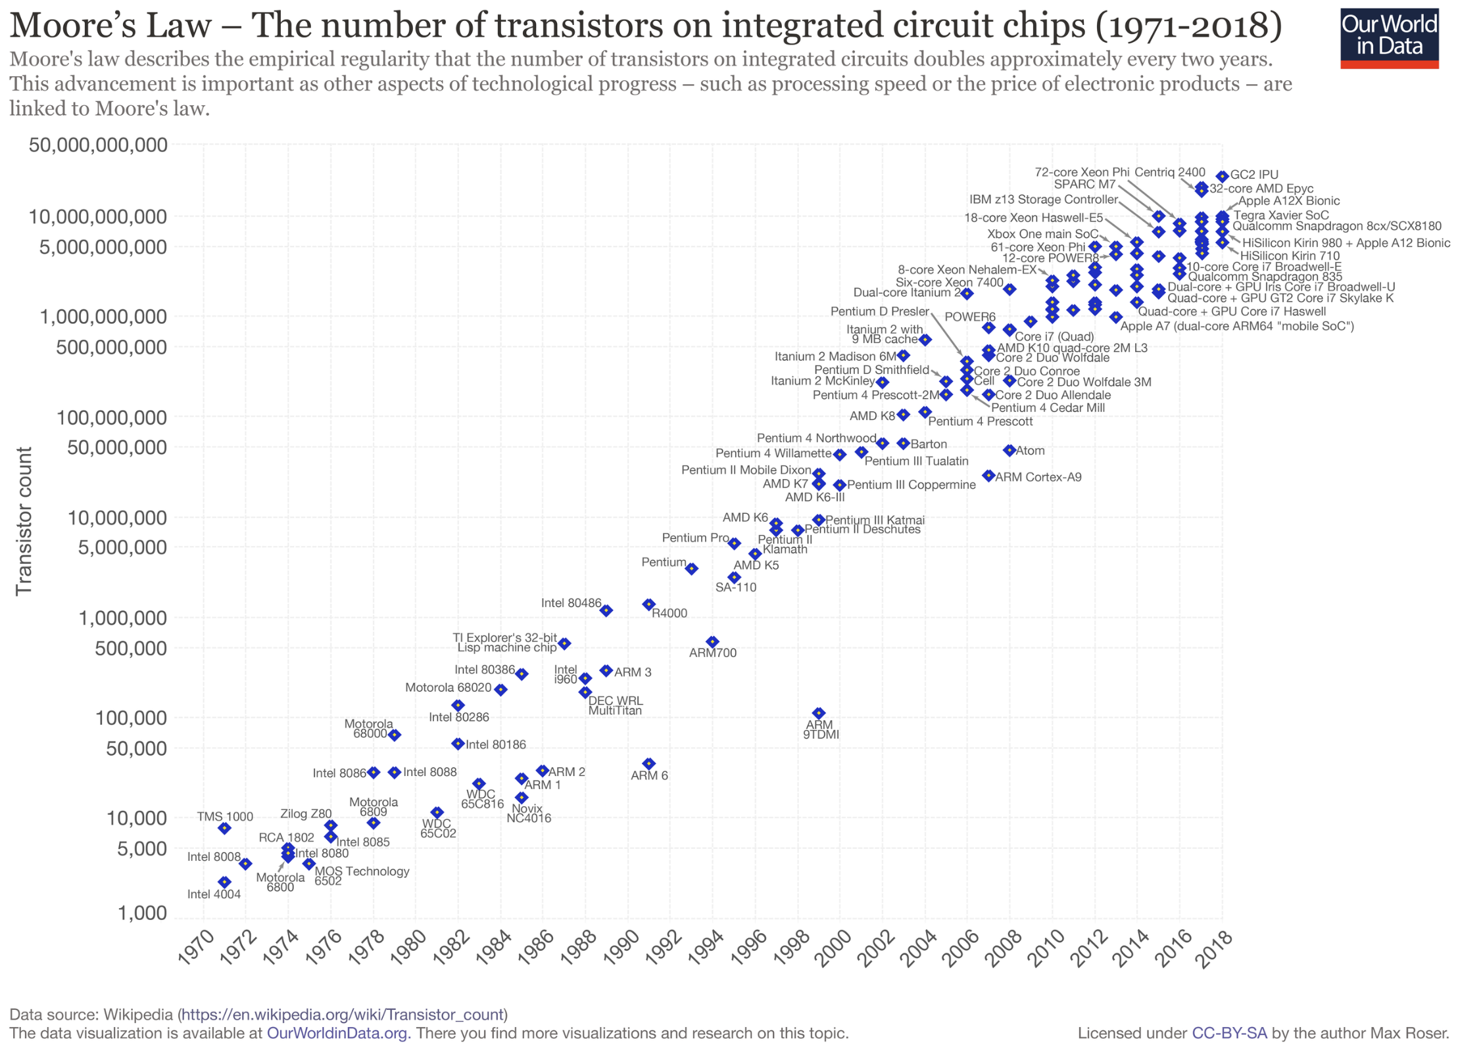

Slide 13

The first solid-state transistor
(Bardeen, Brattain & Shockley, 1947)

Slide 14

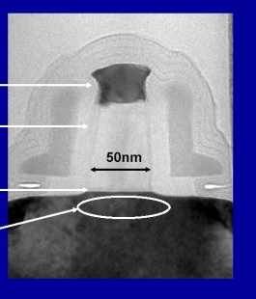
The Ant and
the Pentium
~100 million transistors
INTEL
Pentium 4
transistor
Size of an atom
~ 0.1nm

Slide 15
Quantum Computing
“use of quantum mechanical systems to perform mathematical computations”
Motivation :
Richard Feynman (1981) = observed that simulating the dynamics of quantum systems requires classical resources exponential in the size of the system; wondered what size quantum systems needed to simulate classical dynamics
Peter Shor (1994) = developed quantum algorithm for finding prime factors; showed it scales in time as a polynomial (n^{p}) rather than exponential (q^{n})
Important for complex calculations: molecular dynamics, nonlinear systems,
fluid dynamics (weather), combinatorics (cryptography), global nuclear war, etc.

Slide 16
Shor's algorithm is a quantum computer algorithm for integer factorization. Informally, it solves the following problem: Given an integer N, find its prime factors. It was invented in 1994 by the American mathematician Peter Shor.
On a quantum computer, to factor an integer N, Shor's algorithm runs in polynomial time (the time taken is polynomial in log N, the size of the integer given as input). Specifically, it takes quantum gates of order ((log N)²(log log N)(log log log N)) using fast multiplication, thus demonstrating that the integer-factorization problem can be efficiently solved on a quantum computer and is consequently in the complexity class BQP.
A hard problem: factoring large integers:
For example, it is hard to factor 167,659
But an elementary school student can easily multiply 389 x 431 = 167,659
This asymmetry in the difficulty of factoring vs. multiplying is the basis of public key encryption, on which everything from on-line transaction security to ensuring diplomatic secrecy depends.

Slide 17
Lov Grover (1996) = algorithm for “exhaustive search” 
identify an item having a specific property out of N items
classical algorithm requires N/2 steps to succeed 50% of the time
quantum algorithm requires only N^{1/2} steps
useful for many computations
Example: Data Encryption Standard
2⁵⁶ bit code = 7 x 10¹⁶ possible keys
classical computer ~ 1000 years
quantum computer ~ 4 minutes !
@10⁶ keys per second

Slide 18
Quantum Supremacy
In quantum computing, quantum supremacy is the goal of demonstrating that a programmable quantum device can solve a problem that classical computers practically cannot (irrespective of the usefulness of the problem).^{[1][2]}
By comparison, the weaker quantum advantage is the demonstration that a quantum device can solve a problem merely faster than classical computers. Conceptually, this goal involves both the engineering task of building a powerful quantum computer and the computational-complexity-theoretic task of finding a problem that can be solved with current technology and has a believed superpolynomial speedup over the best known or possible classical algorithm for that task.^{[3][4]} The term was originally popularized by John Preskill^{[1]} but the concept of a quantum computational advantage, specifically for simulating quantum systems, dates back to Yuri Manin's (1980)^{[5]} and Richard Feynman's (1981) proposals of quantum computing.^{[6]}

Slide 19
Classic vs. Quantum Logic
CLASSICAL LOGIC: two distinct states
“bit”
can do all operations from NOT and exclusive-OR gates
Single-bit
operation
Two-bit
operation
perform series of operations on bits to get final answer
QUANTUM LOGIC: superposition of two quantum levels
“qubit” = quantum bit
can do all operations from single-qubit and controlled-NOT functions
unitary transformations
(e.g. rotations)
Two-qubit
operation
“Entangle” qubits and allow quantum evolution to “project out” answer

Slide 20
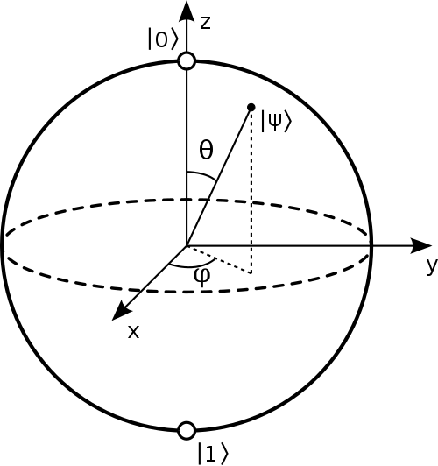
Representing qubits --- the Bloch sphere

Slide 21
Key to quantum computation = entanglement
qubit = quantum two-level system
E₁
Superposition:
E₀
0
1
q
Entanglement: interference of two qubits
Performing logic operations with entangled states allows the quantum evolution to sample multiple states … effectively massive parallel computation
Quantum mechanically, a register of N entangled qubits can store 2^{N} states in superposition:
e.g.
A 300-qubit register can simultaneously store
2³⁰⁰ ~ 10⁹⁰ numbers
2037035976334486086268445688409378161051468393665936250636140449354381299763336706183397376
This is more than the total number of particles in the Universe!
(Google SC quantum computer has 57 qubits = only 144,115,188,075,855,872 states)
Some problems benefit from this exponential scaling, enabling solutions of otherwise insoluble problems.

Slide 22
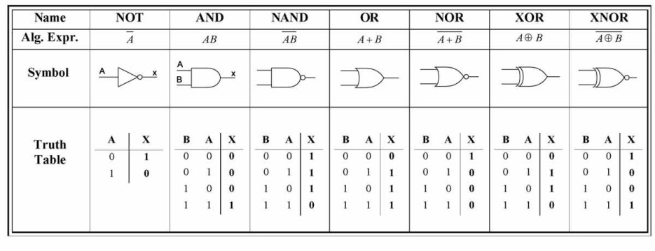
Classical vs. Quantum logic --- gates and algorithms (cont’d)
Because the bits are different, the logic operations are different also
CLASSICAL LOGIC
Classic logic gates operate on discrete binary bits --- there are 7 types of logic gates:
Classical algorithms consist of sequences of these logic operations, sometimes performed in parallel in large computers

Slide 23
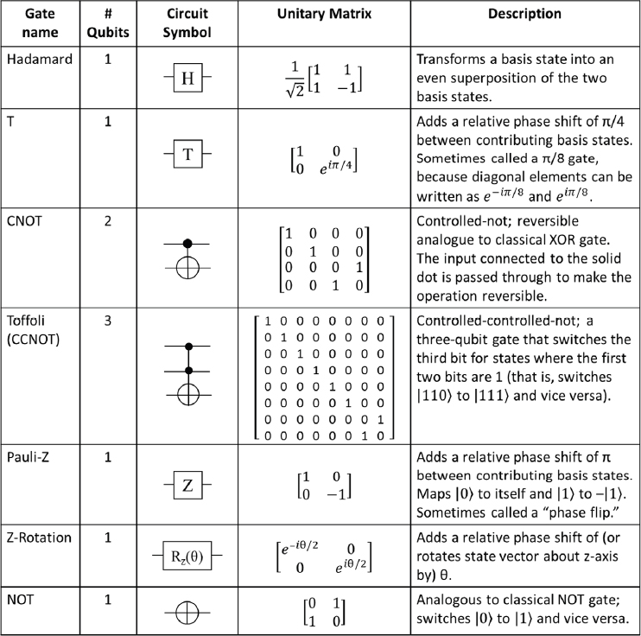
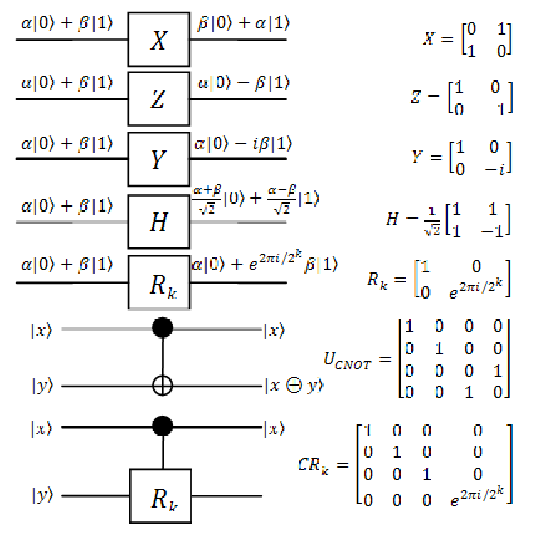
Classical vs. Quantum logic --- gates and algorithms (cont’d)
QUANTUM LOGIC
Quantum logic gates operate on single qubits and pairs of qubits

Slide 24
Classical vs. Quantum logic --- gates and algorithms (cont’d)
A few other important differences:
Quantum gates are reversible --- classical gates are not.
  That means that the input data is destroyed in the classical operations but is retained in the quantum system
2. Classical gates (if they work) give an exact result --- quantum gates give superpositions of states which are characterized by probabilities
  That means (1) that you need “high-fidelity” readouts of the state that can distinguish which state the system is in after an operation, and (2) even with perfect fidelity that you need to work with ensembles and do enough measurements to get the final state
3. You need to implement “error-correcting codes” to mitigate accumulated measurements
  That means that there is an “overhead cost”, i.e. to make N functioning qubits, you may need many more physical qubits --- that overhead depends on the system but can be 10-1000 times*
* This is one of prime motivations of topologically-protected qubit platforms since it is proposed that these give error-free operations that will eliminate the need for error-corrections (that is only partially true)

Slide 25
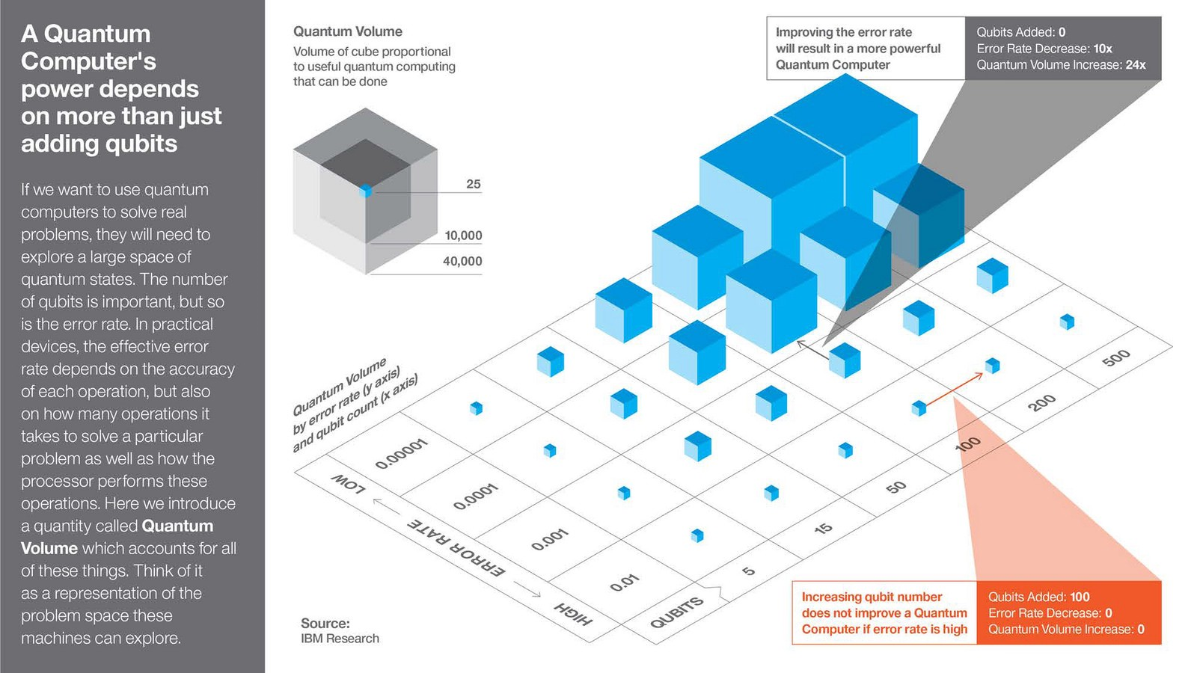

Slide 26
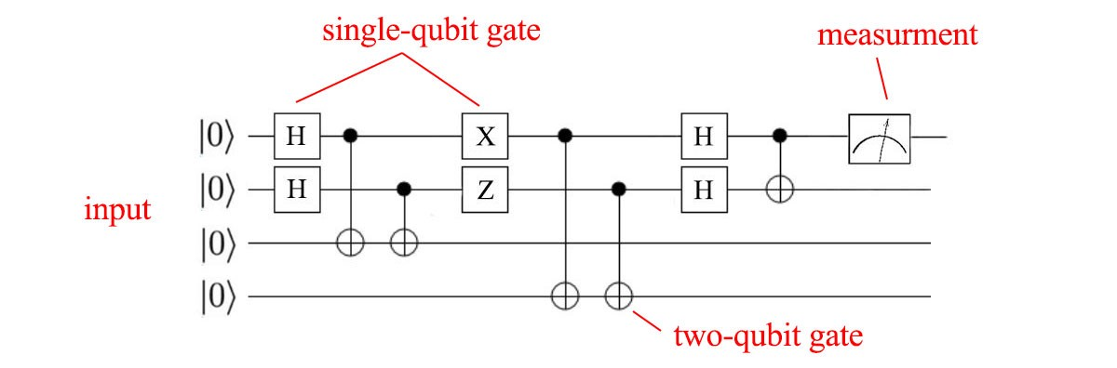
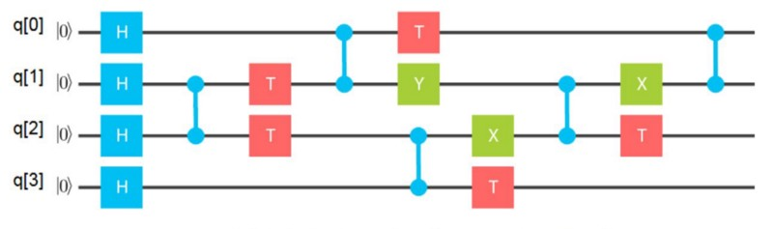
Quantum algorithms consist of sequences of these logic operations, followed by measurements of the resulting quantum states

Slide 27
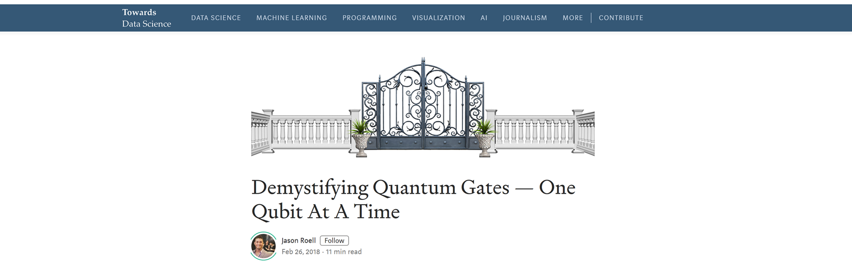
https://towardsdatascience.com/demystifying-quantum-gates-one-qubit-at-a-time-54404ed80640
If you want to get into quantum computing, there’s no way around it: you will have to master the cloudy concept of the quantum gate. Like everything in quantum computing, not to mention quantum mechanics, quantum gates are shrouded in an unfamiliar fog of jargon and matrix mathematics that reflects the quantum mystery. My goal in this post is to peel off a few layers of that mystery.
But I’ll save you the suspense: no one can get rid of it completely. At least, not in 2019. All we can do today is reveal the striking similarities and alarming differences between classical gates and quantum gates, and explore the implications for the near and far future of computing.

Slide 28
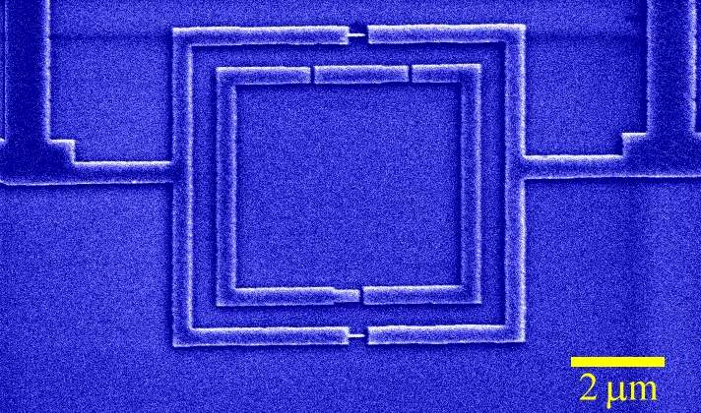
Superconducting devices for Quantum Computing
Intrinsic low temperature quantum system
Characteristic energies and dynamics are well-understood
Good control of fabrication and measurement schemes
Easy to control and couple qubits
Hard to isolate due to many degrees of freedom
QUBIT = rf SQUID
Measurement = dc SQUID
Al device … measurements at 10mK … TU Delft

Slide 29
Requirements for quantum computation (DiVincenzo criteria)
1. Scalable physical system of qubits
qubit = quantum two-level system
bit = classical two-level system
Superposition:
E₁
E₀
Two qubits --- entanglement :
0
1
q
2. Ability to initialize qubits into a particular quantum state
initialization at the start of computation
supply of qubits in low entropy state for quantum error correction

Slide 30
3. Universal set of quantum gates
Classical computer  all operations from NOT and exclusive-OR
Quantum computer  all operations from single qubit rotations and the two-qubit controlled-NOT
Quantum algorithm = sequence of unitary transformations
4. Qubit-specific measurement capability
Quantum measurement:
probability of
probability of
Need to measure the state of each qubit without perturbing the state of the others
Ideal if the measurement does not destroy the quantum state of the measured qubit also  non-demolition
Figure of merit = quantum efficiency (<100%)

Slide 31
5. Long decoherence times
Effect of the environment  entangles system with the environment (bad) … or, makes a measurement on the system
Decoherence time criterion is hard to define … depends on specific system and type of measurement to be made, but must be:
“long enough that the uniquely quantum features of the computation have a chance to come into play”
System must maintain phase coherence during the execution of sequences of logic operations (~10⁴ –10⁵) , but not for the duration of the entire calculation
Quantum error correction (Shor, 1996)
Implications:
reduce internal dissipation of the system
isolate system as much as possible from the environment

Slide 32
QUBIT implementation
1. Must be able to entangle, manipulate, and readout quantum states
        Functionality
Must be able to isolate system from the environment
      Quantum coherence
Develop architecture that allows coupling of multiple qubits
      Scalability
Ion traps
Photons
Superconductors
Atomic systems
(not easily scalable)
Functionality
NMR
Quantum dots
system size
Spintronics
Solid state systems
(scalable)
Quantum Coherence

Slide 33
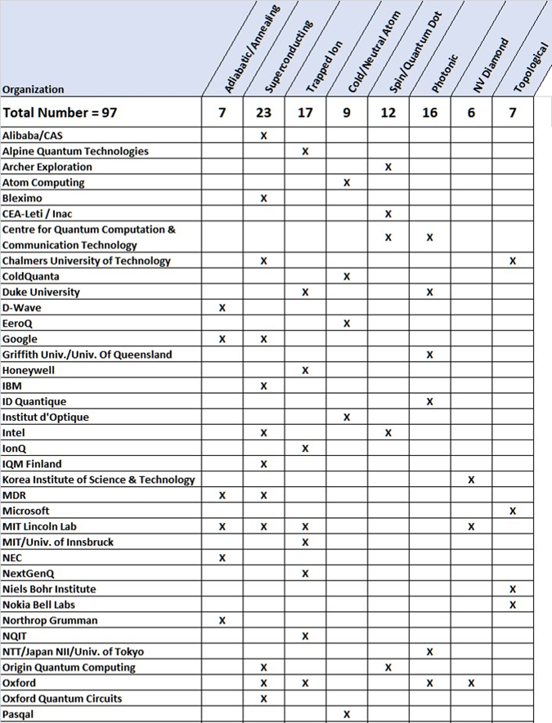
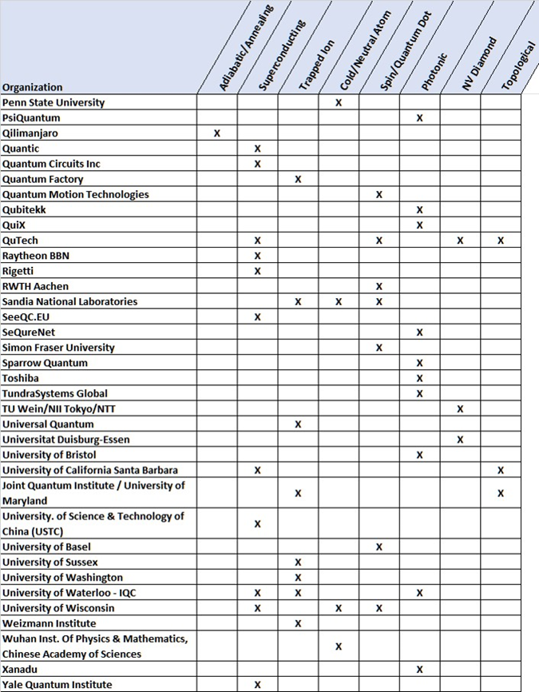
Comparison of qubit technologies

Slide 34
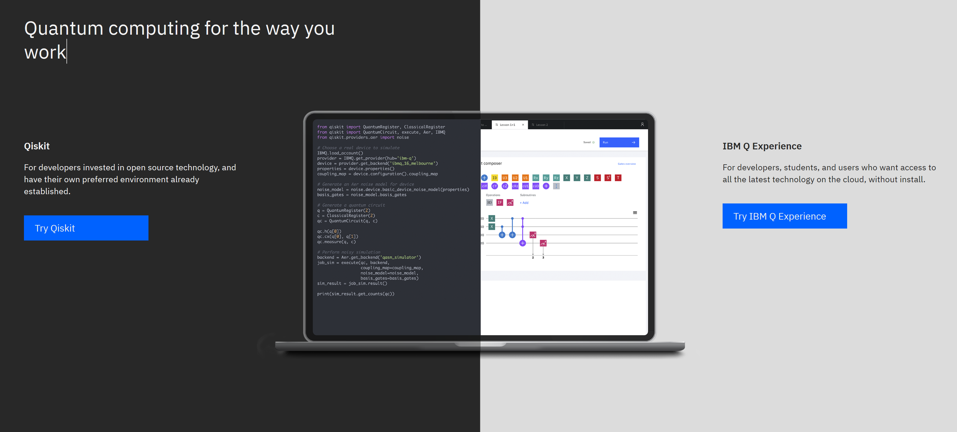

Slide 35
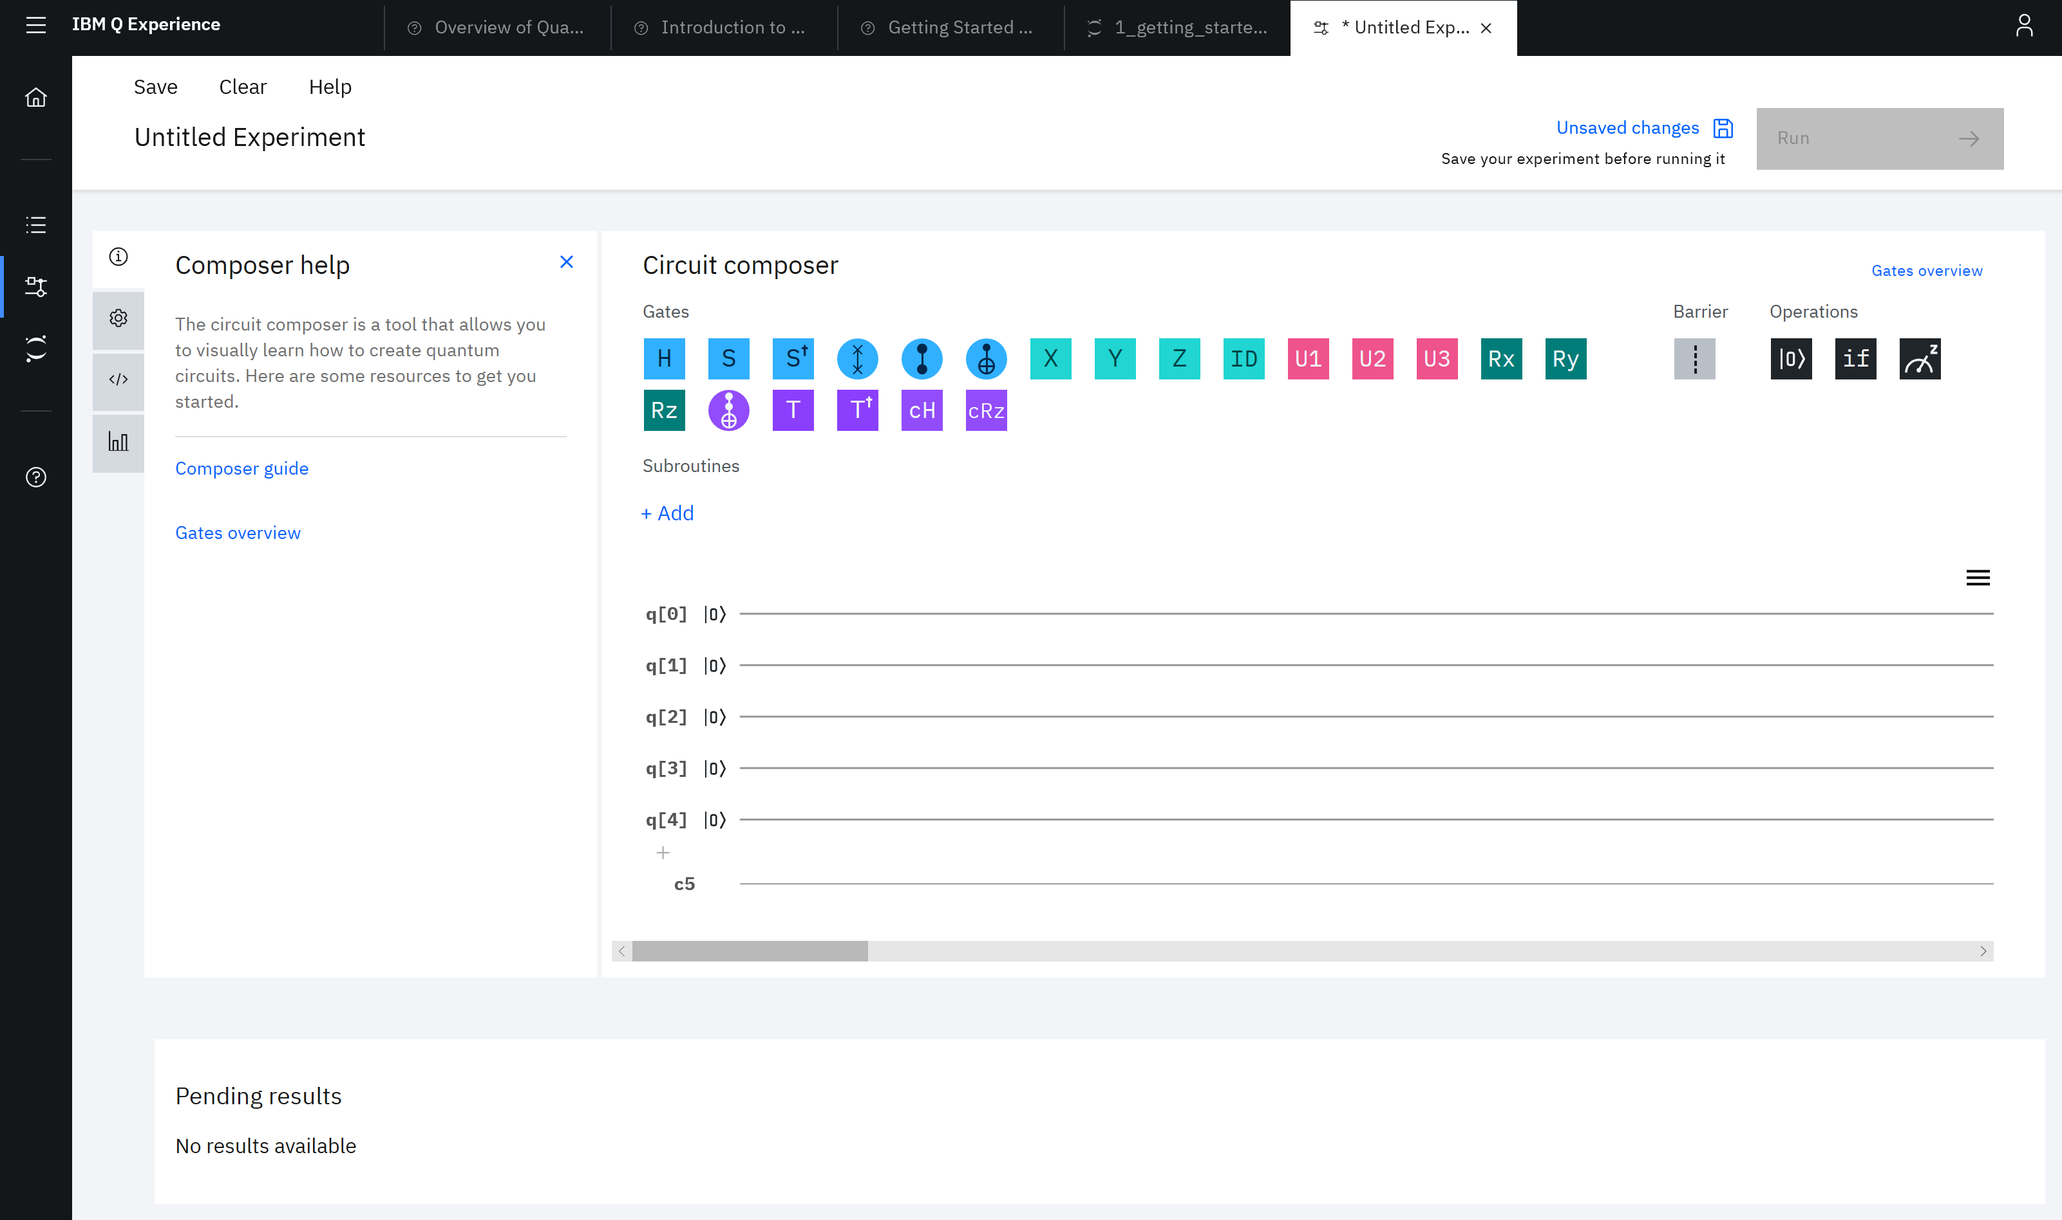

Slide 36
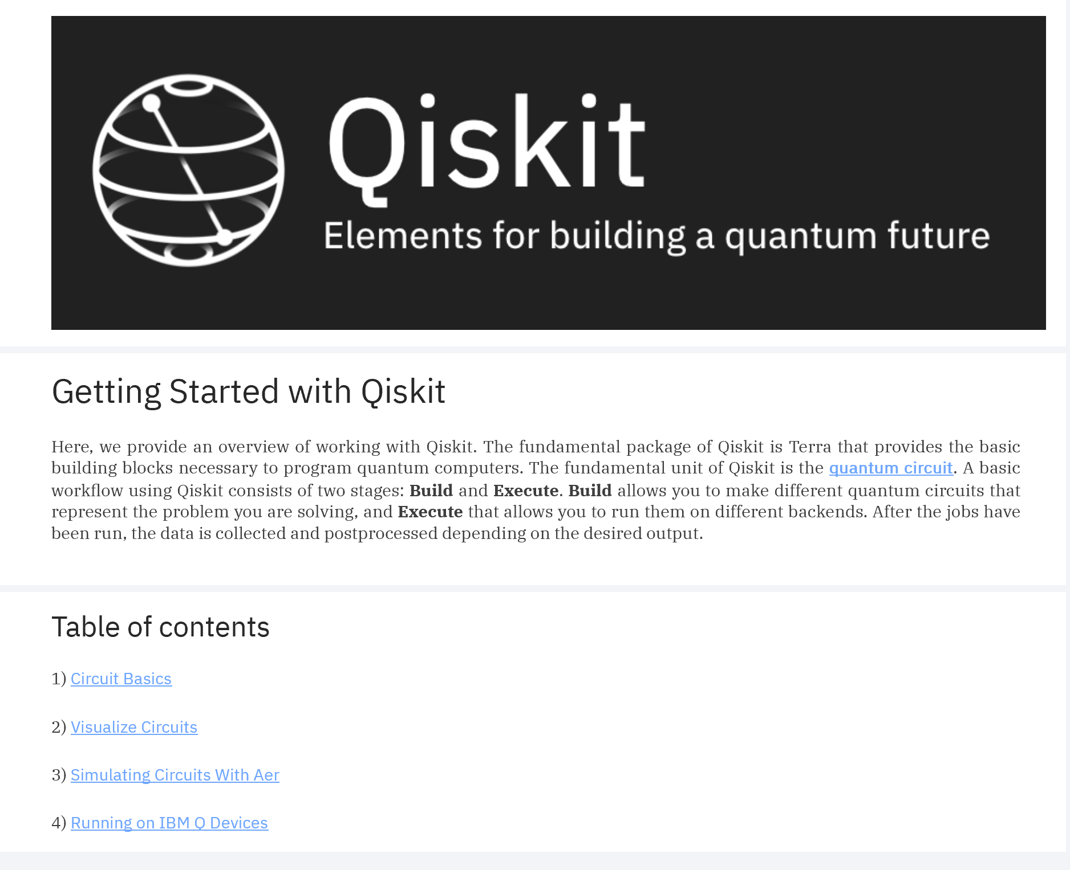

Slide 37
https://www.ibm.com/quantum-computing/

